Slide 1

Project Game – TEAM 2

Slide 2


CATEGORY
IDEA
STORY
GAME PLAY
Projec Game – TEAM 2

Slide 3
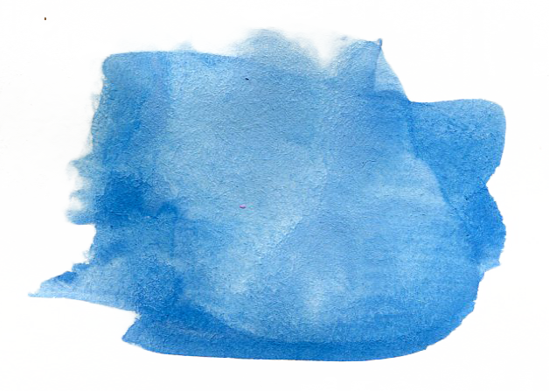
1
IDEA

Slide 4

Had inspiration from Bubble games.
Combined with
Defense games.

Slide 5
2
STORY

Slide 6


Slide 7

GAMEPLAY

Slide 8


Slide 9
Thanks!
Any questions?

